Slide 1

Frontier Developments
By Tom Booth

Slide 2
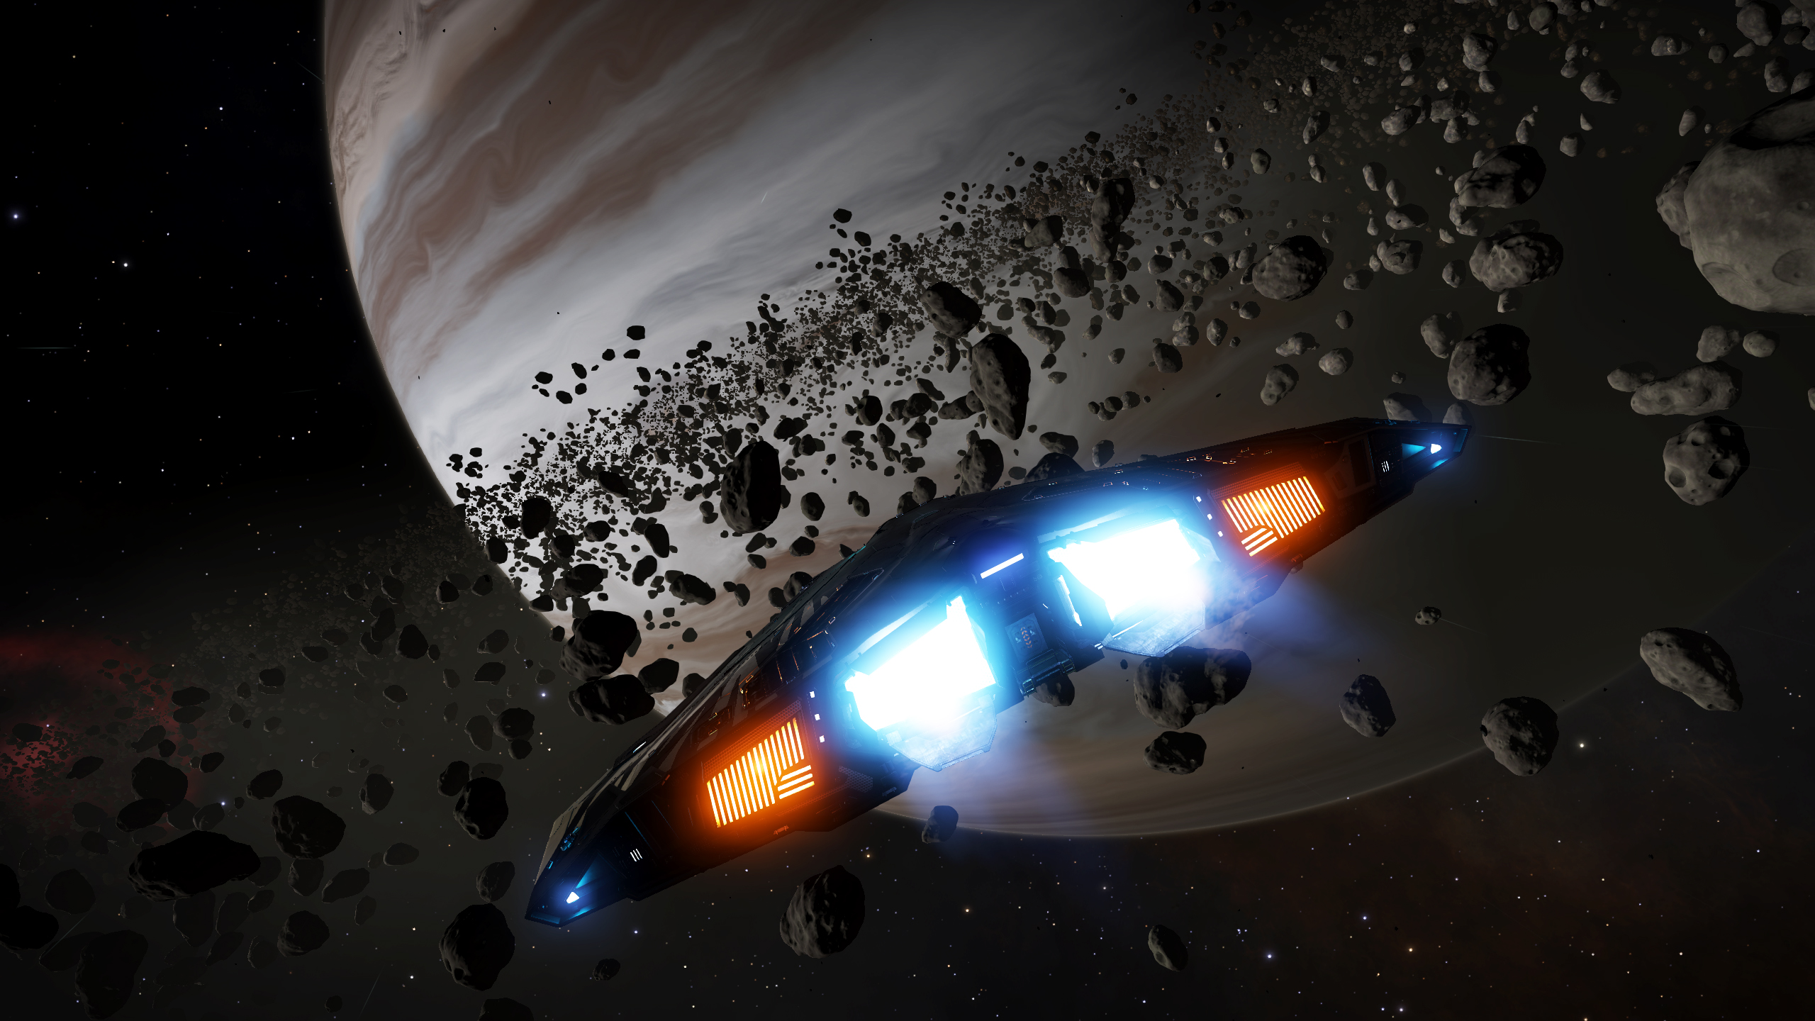
What is Frontier?
Frontier Developments is a British Video Game developer founded in January of 1994 by David Braben.
Most well known for developing the Elite Dangerous Series
However it also develops a plethora of other games as well, such as Jurassic World: Evolution

Slide 3

Elite?
Originally released on all general computer platforms in 1984
Best known for it’s revolutionary 3D graphics, including wire-frame technique
Includes games: Elite (1984), Frontier: Elite II (1993), Frontier: First Encounters (1995) and finally Elite Dangerous (2014)

Slide 4

The Stellar Forge
Incredibly detailed, developed in-house engine for generating Elite Dangerous’s Galaxy
Procedurally generates our own galaxy with INCREDIBLE precision!
https://youtu.be/Vz3nhCykZNw?t=3202

Slide 5
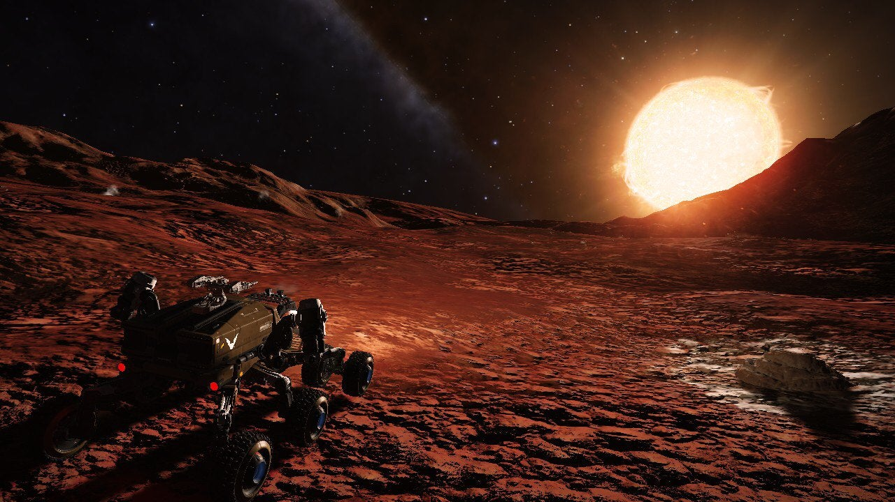
Video Game Photography

Slide 6
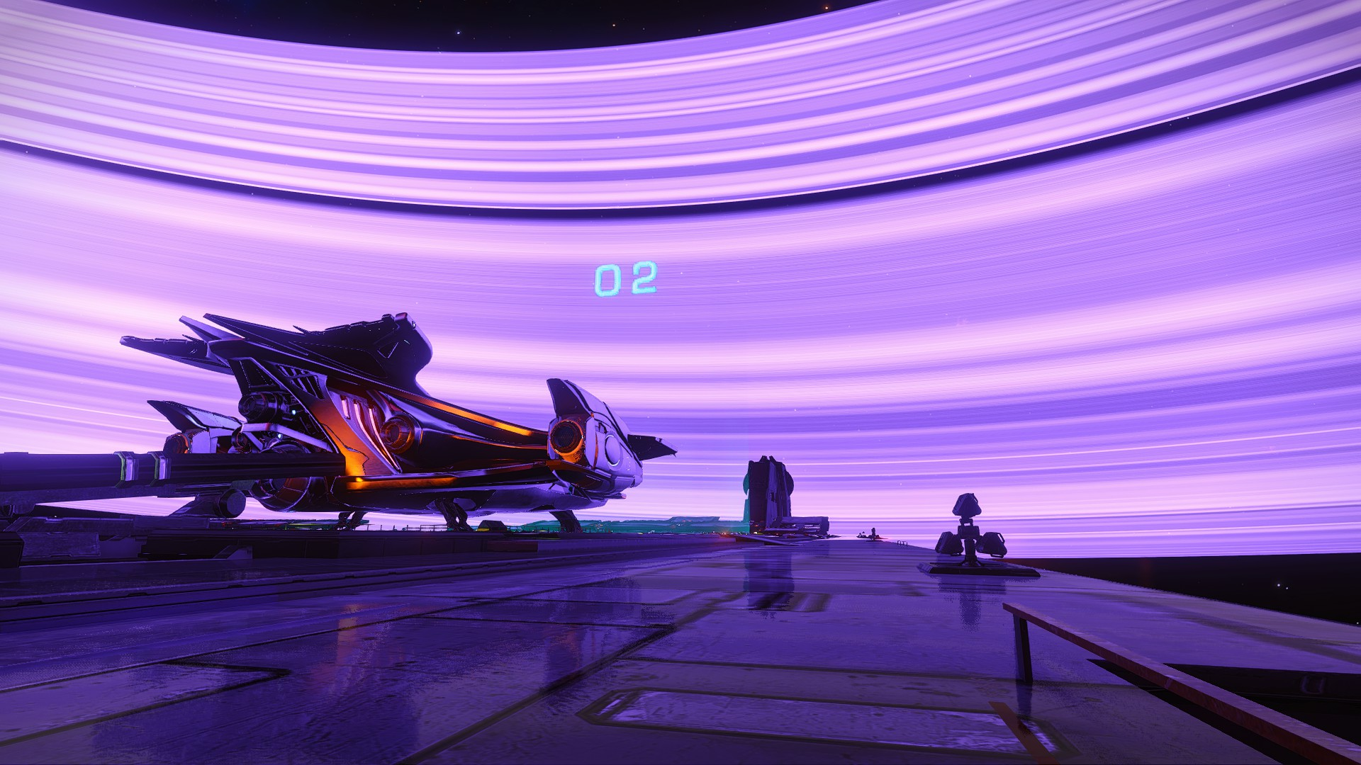

Slide 7
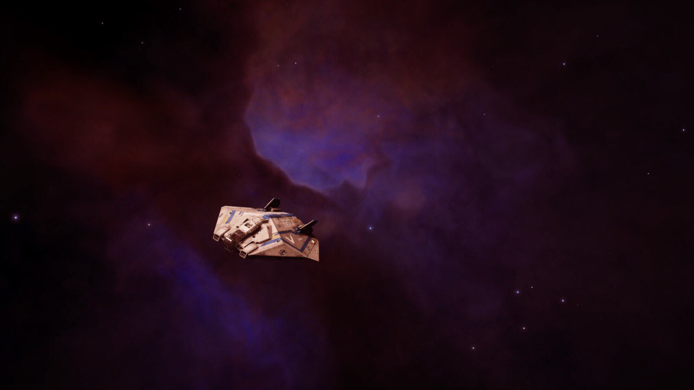

Slide 8
Works Cited
https://www.youtube.com/watch?v=Vz3nhCykZNw&t=3202s
https://www.frontier.co.uk/
https://en.wikipedia.org/wiki/Elite_(video_game)
https://www.youtube.com/watch?v=ezGDH7hoEsk
https://www.pcgamesn.com/elite-dangerous/elite-dangerous-shows-us-the-science-and-technology-behind-creating-realistic-planets

